Slide 1

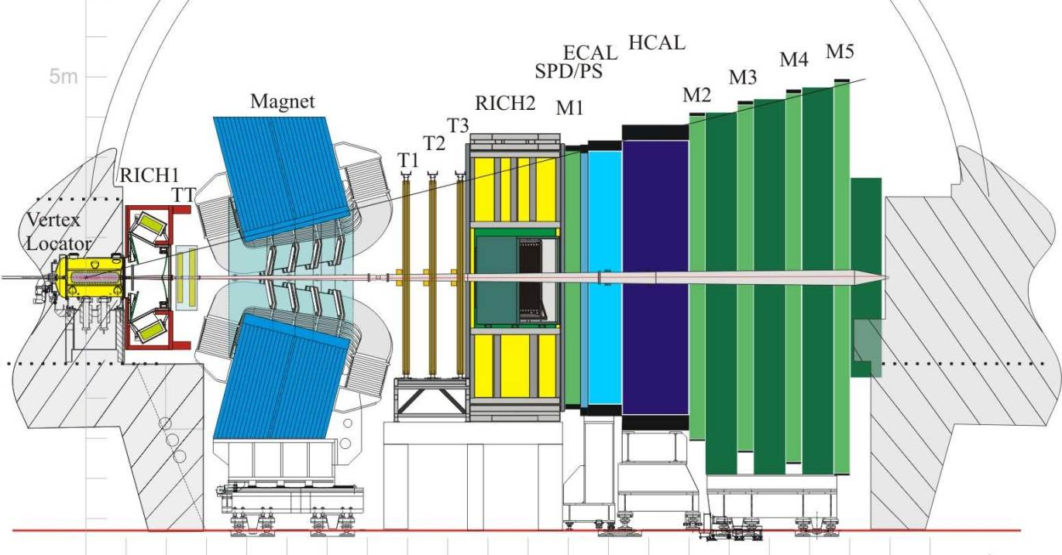
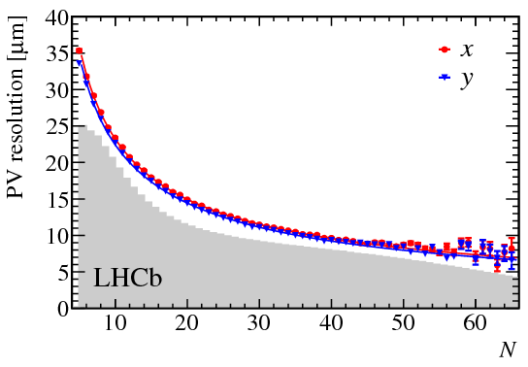
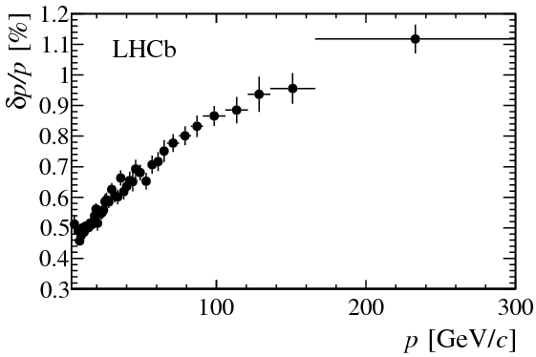
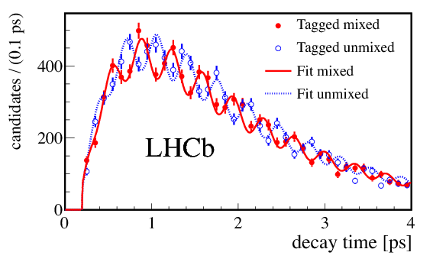
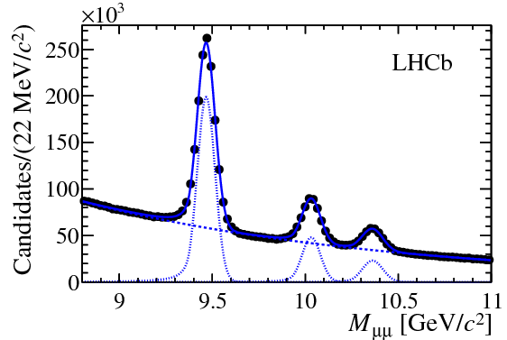
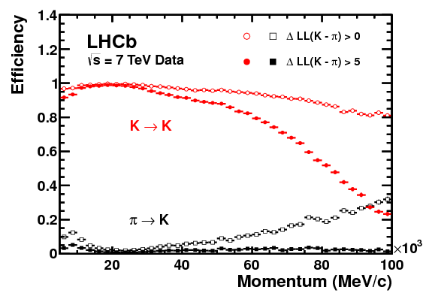
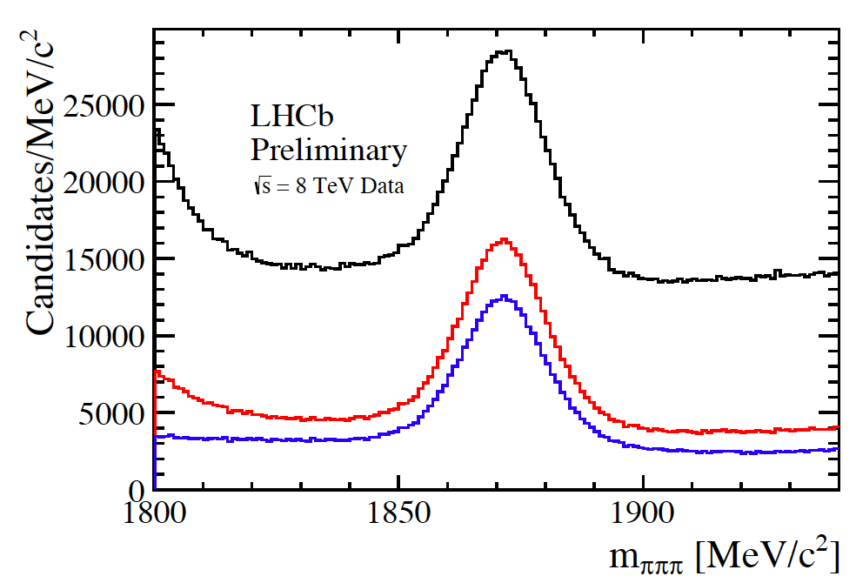
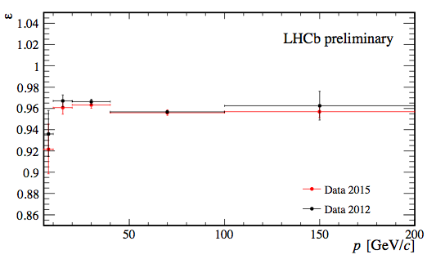
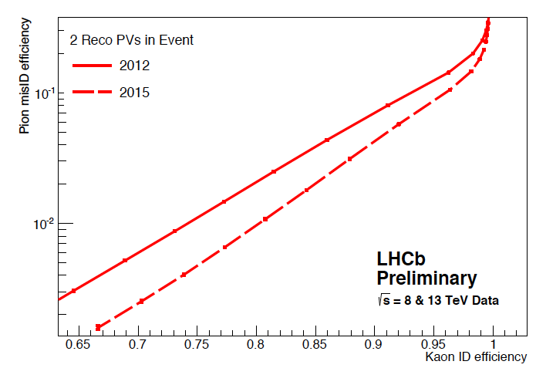
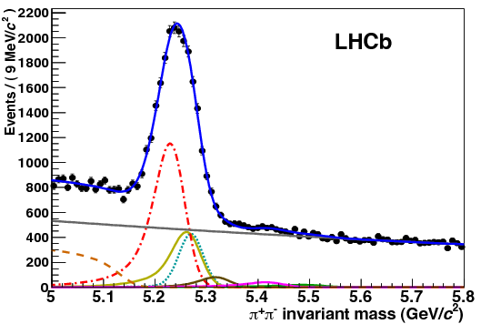
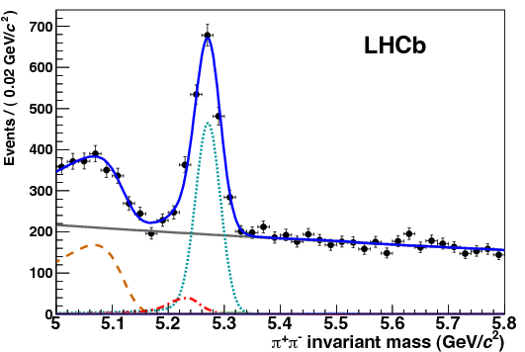
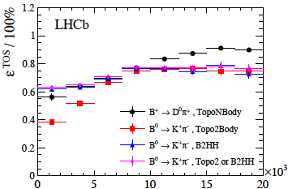
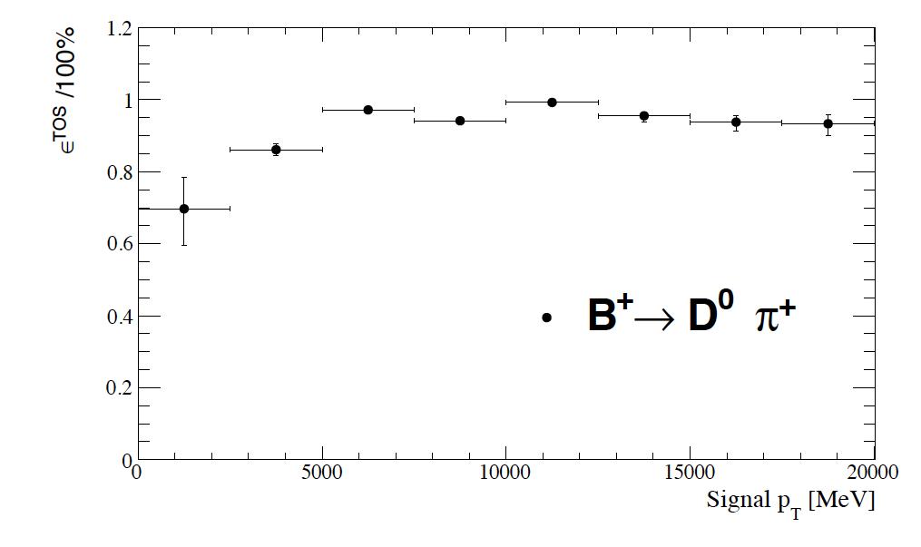
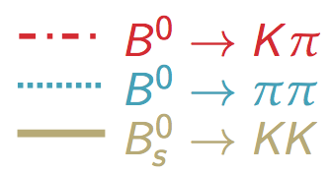
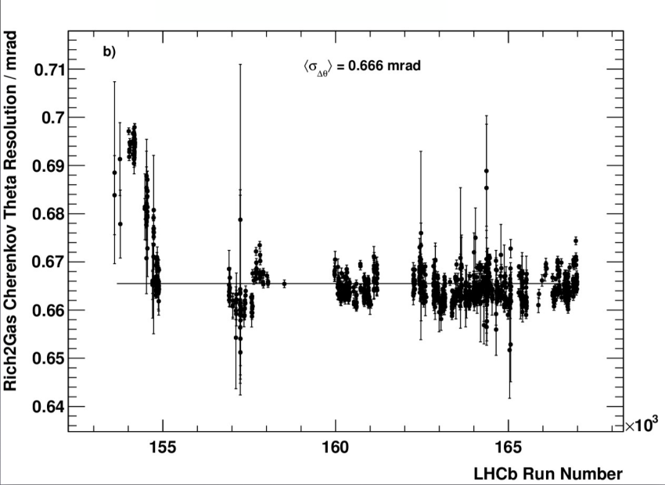
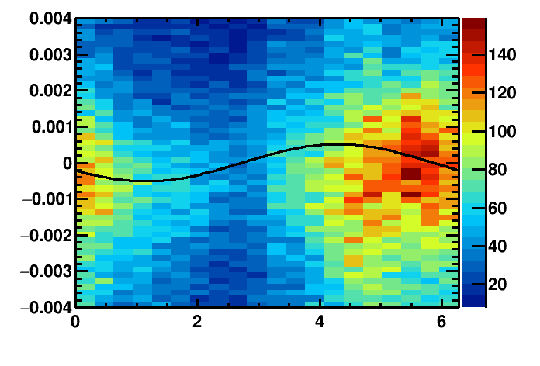
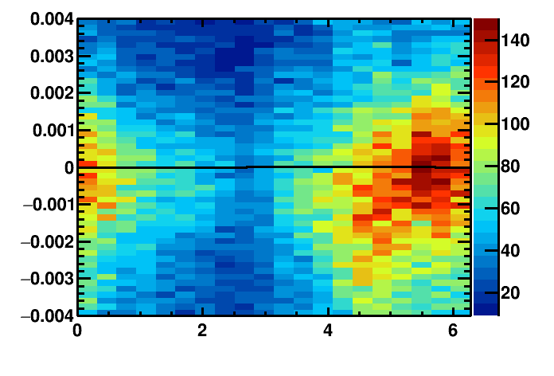
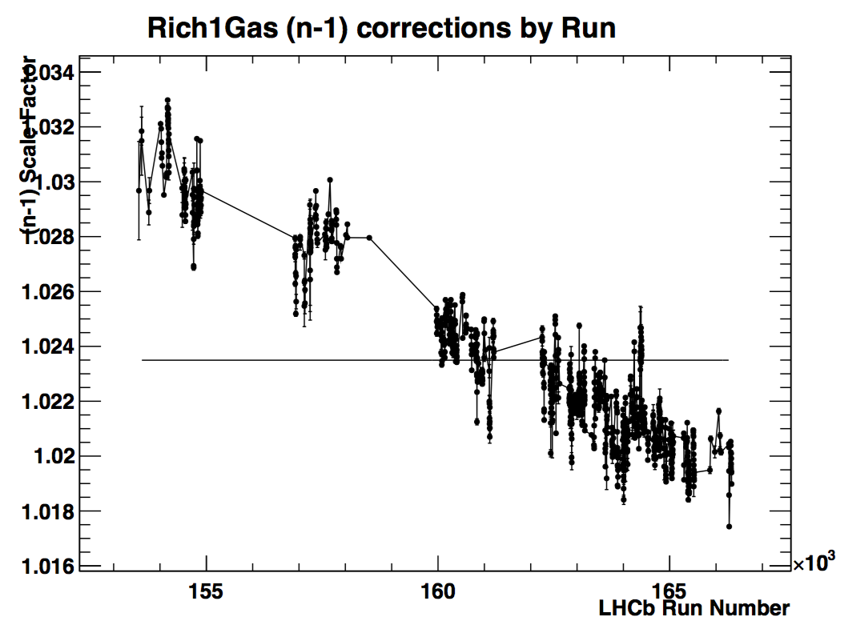
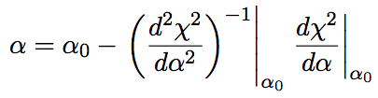
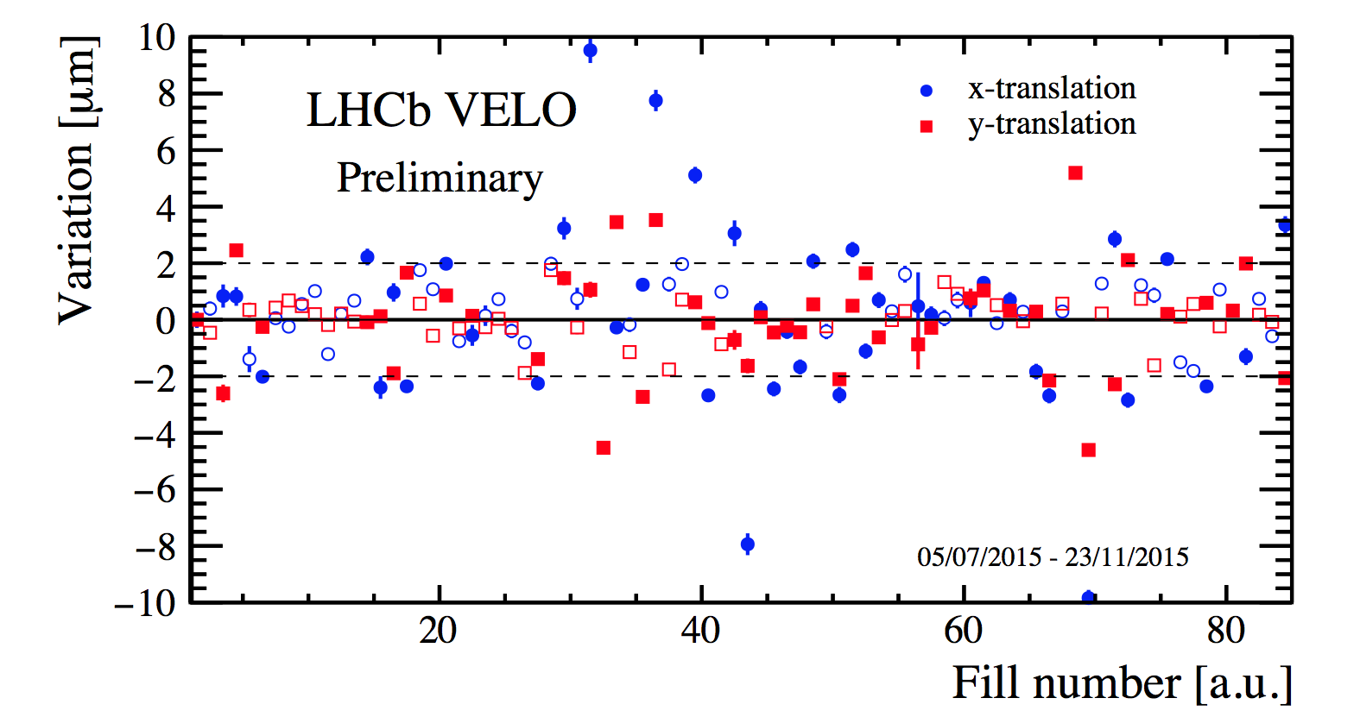
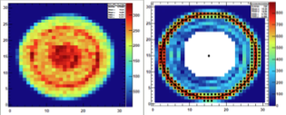
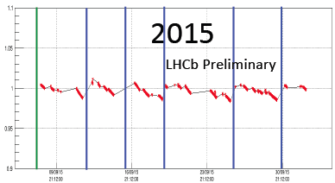
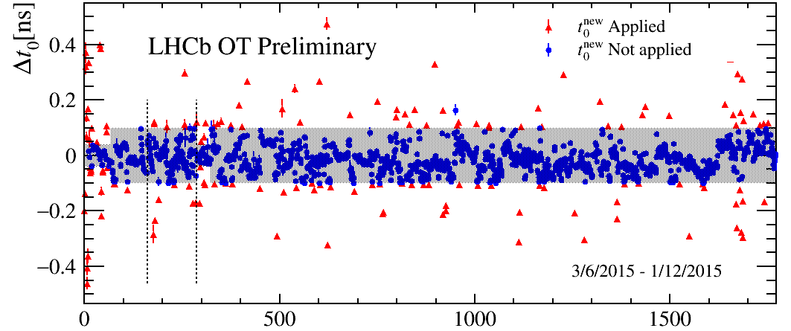
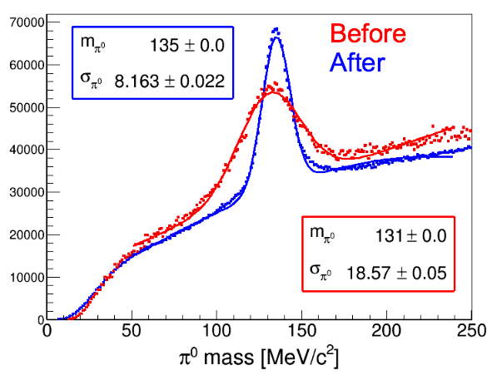
Novel Real-time Calibration and Alignment Procedure for LHCb Run II
Claire Prouve, on behalf of the LHCb collaboration
New challenges in Run II
The LHCb Detector
xxx
Increase in energy: √s = 7(8) TeV ⇒ 13 TeV
15% increase of inelastic collision rate
20% increase of multiplicity per collision
60% increase of σ_{bb ̄} and σ_{cc ̄}
Reduced bunch spacing: 50 ns ⇒ 25 ns
2.4 · 10¹² B hadrons in LHCb detector acceptance in 2011 + 2012
Vertex resolution
Momentum resolution
Real Time Alignment and Calibration
J/Ψ→μ⁺μ⁻
xxx
Particle identification useable in HLT2
Overall improved HLT2 efficiency
Stable quality of alignment
No more differences between online and offline
Decay-time resolution
Mass resolution
PID efficiency
PID impact D⁺→π⁺π⁻
Dimuon resonances
Trigger
+PID
+tighter PID
B_{s}⁰ →D_{s}⁻ π⁺
LHCb Trigger Schemes
References:
[1] R. Aaij et al., Int.J.Mod.Phys. A30, 1530022 (2015). [2] R. Aaij et al., JINST 9, 09007 (2014). [3] J. Amoraal et al., Nucl.Instrum.Meth. A712, 48 (2013).
[4] M. Adinolfi et al., Eur.Phys.J. C73, 2431 (2013). [5] W. Hulsbergen, Nucl.Instrum.Meth. A600, 471 (2009). [6] R. Arink et al., LHCb-DP-2013-003.
Performance and Impact on Physics
PID efficiency
First alignment
Improved alignment
Tracking efficiency
σ_{Υ(1S)} = 86 MeV/c²
σ_{Υ(1S)} = 44 MeV/c²
Without PID
With PID
Trigger efficiency: Run I and Run II
Alignment Farm and Framework
RICH Mirror Alignment
signal p_{T}[MeV]
ccc
Alignments performed for each fill
HLT1 line for each task
Event reconstruction parallelised on analysers (1700 nodes), computing of alignment constants by iterator (1 node)
Steered by the run control using a Finite State Machine
VELO, Tracker & calibrations: automatic update of the constants if they differ by a given value
RICH alignment & Muon System: monitoring mode
Orientation of the RICH mirrors in x and y
Fit the variation of the Cherenkov angle Δθ as a function of the polar angle ϕ to extract the misalignments on the detector plane (Θ_{x}, Θ_{y}):
Δθ = Θ_{x} sinϕ+ Θ_{y} cosϕ
Monitoring mode, updated O(10) times a year
~30 minutes per task
Example of alignment sequence
RICH1 Stability
Run number
Misaligned mirrors
Aligned mirrors
Cherenkov angle
Cherenkov angle
RICH Calibration
Azimuthal angle ϕ
Azimuthal angle ϕ
Refractive index calibration: Fit to the reconstructed-expected Cherenkov angle yields scale factor for the refractive index
HPD image calibration: Sobel filter applied to each HPD and used to provide calibration
Updated every run
Tracker Alignment: VELO, Tracker, Muon System
RICH1 scale factor
xxxsssss
Position of the tracking elements in x and y
Minimisation of residual of Kalman track fit using additional constraints
Independent alignments:
VELO & Tracker: updated every O(1) fills
Tracker: updated every O(1) weeks
Muon system: updated O(1) per year
~7 minutes for each task
VELO Stability
HPD image
Calorimeter Calibration
ccc
Relative calibration for each cell
Scale the High Voltage by factor α to keep the gain stable by evaluating the variation of the occupancy
LED monitoring system to detect ageing of the Photo Multiplier Tubes
Updated per fill
Calibrate to the neutral π mass
Fit the π⁰ mass distribution for each cell for π⁰ γγ, where one γ has its seed in the cell
Run on the HLT-farm during TS
LED average
Outer Tracker Calibration
xxx
Global time alignment for all modules
Fit the residual of the drift time to extract the global time delay t₀ caused by readout electronics
t_{meas} = t₀ + t_{flight} + t_{drift} + t_{prop}
Updated every O(10) runs
OT Stability
π⁰ calibration
Run number
LHCC - 02 March 2016 - Poster Session

